Slide 1
Project 3 - Travel RAG Chatbot Project
AI-Powered Travel Assistant with Governance & LLMOps

Slide 2
Ground Rules : Important
Ground rules for setting up an Azure Resources for this project
Utilize the default resource group for all your tasks
NOTE: To optimize resource management, use the existing resource group i.e default_resource_group for all tasks in the project
Avoid creating multiple resources and resource groups to ensure consistency, simplify monitoring, and reduce overhead
Select Region = East US for the Azure AI Foundry
Pricing tier: Standard S0 pricing tier
If Azure AI Foundry has already been deployed, the setup process for it can be skipped, and the focus can shift directly to deploying the model(s)
Allow 10 to 15 minutes for resources to become fully operational following its creation

Slide 3
Instructions
All screenshots should be clear, high-quality, and legible, ensuring that details are easily visible
Wherever applicable, the learner's account details should be visible to verify ownership and authenticity
Red boxes should be correctly placed to highlight the key steps in each screenshot, ensuring clarity and guiding the viewer through the process
The overall structure and logical flow of the process must be maintained by placing each screenshot under the appropriate slide headers
Learners should avoid skipping steps or presenting them in an incorrect order, as this can disrupt the coherence of the submission

Slide 4

Step 1: Define Business context and objective
Proprietary content. © Great Learning. All Rights Reserved. Unauthorized use or distribution prohibited.

Slide 5
1.1 Problem Statement
Travel information is distributed across multiple documents and structured datasets, making it difficult for users to quickly identify relevant and reliable answers through conventional search.
Build a governed RAG-based travel assistant that transforms fragmented travel knowledge into accurate, context-aware responses.
          The solution needs to:
          Understand natural-language travel queries
          Retrieve semantically relevant information
          Generate responses grounded in retrieved content
          Apply governance checks to inputs and outputs
          Provide visibility into application execution and retrieval performance

Slide 6
1.2 Business Context
Travel customers frequently need information related to:
Airline policies
Refund and cancellation rules
Baggage information
Travel guidance
Other destination/travel-related information
Manually searching through individual documents can be inefficient, particularly when the user's terminology does not exactly match the source documents.
Vector search helps address this because queries and documents can be represented as embeddings and matched based on semantic similarity.
Business Value
Faster Information Access | Consistent Responses | Better User Experience | Grounded Answers | Improved Governance

Slide 7
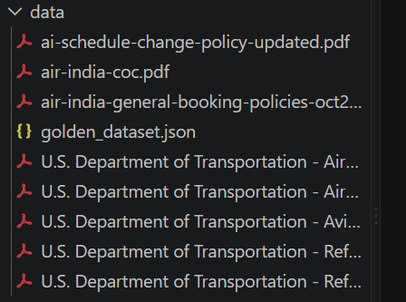
1.3 Data Description
Your “TravelDataLoader” implementation handles the source information and converts source content into document objects suitable for the RAG pipeline.
Data processing characteristics
Source travel documents loaded from the project data repository
Content converted into standardized document objects
Long documents split into smaller overlapping text chunks
Metadata retained to support source identification
Chunks converted into vector embeddings
Embeddings and content indexed in Azure AI Search

Slide 8
1.4 Data Source
Data Source | Format | Purpose | Processing
Travel knowledge documents | PDF | Travel policies and reference information | Text extraction → Chunking
Travel structured data | CSV | Structured travel-related information | Row-level document conversion
Document metadata | Metadata | Source/category identification | Retained with chunks
Vector embeddings | Numerical vectors | Semantic representation of content | Indexed in Azure AI Search

Slide 9
1.5 Solution methodology
Write the solution methodology here
Stage | Approach
1. Ingest | Load PDF & CSV travel knowledge
2. Prepare | Extract, chunk & enrich with metadata
3. Vectorize | Generate embeddings using Azure OpenAI
4. Index & Retrieve | Store & semantically search using Azure AI Search
5. Generate | Ground LLM response using retrieved context
6. Govern & Monitor | Validate input/output and track execution through MLflow

Slide 10
Step 2: Provision Azure Resources
Proprietary content. © Great Learning. All Rights Reserved. Unauthorized use or distribution prohibited.

Slide 11
Azure Services
(In this section, provide details of the Azure services required for the project and their purpose)
Azure Service | Purpose in Project | How Used
Azure OpenAI / Microsoft Foundry | Provides AI models for embeddings and response generation | Converts text/query into embeddings and generates grounded responses
Azure AI Search | Vector knowledge store and retrieval engine | Stores document chunks + vectors and retrieves semantically relevant content
Azure Resource Group | Logical resource organization | Groups project-related Azure resources
Azure Content Safety (if configured) | Additional content governance | Supports assessment of unsafe input/output content
Document Chunk
↓
Embedding Vector
↓
Azure AI Search
↓
Vector Index
wandernest-travel-index
↓
Top-K Similar Documents

Slide 12
Azure Foundry Service
Proprietary content. © Great Learning. All Rights Reserved. Unauthorized use or distribution prohibited.

Slide 13
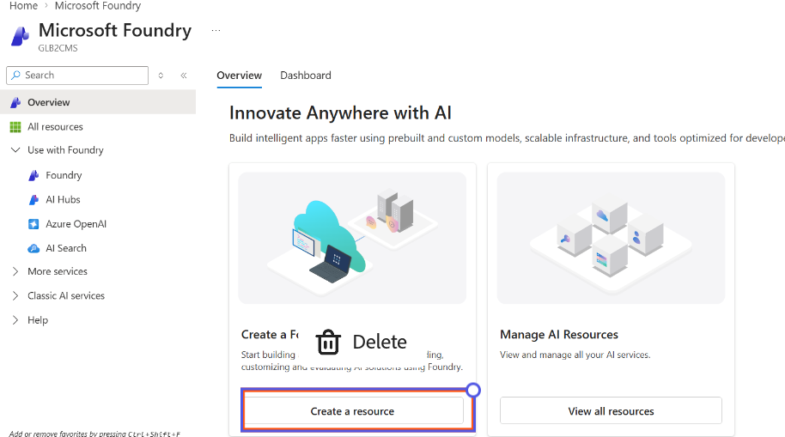
2.1 Azure AI Foundry Resource creation
(Put the screenshots and details during Azure AI Foundry Resource creation here)
Proprietary content. © Great Learning. All Rights Reserved. Unauthorized use or distribution prohibited.

Slide 14
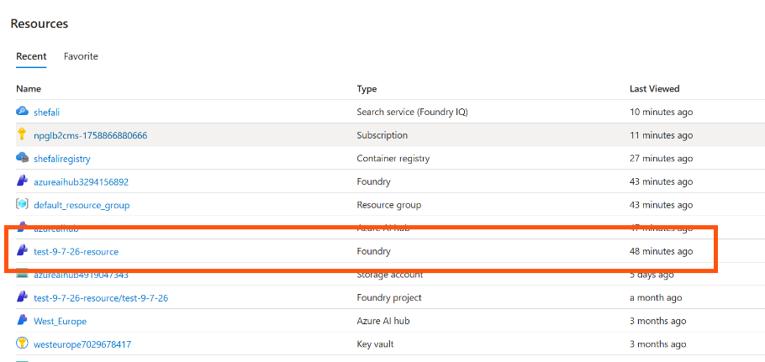
2.2 Azure AI Foundry Interface
(Put the screenshot of the Azure AI Foundry user interface here)
Proprietary content. © Great Learning. All Rights Reserved. Unauthorized use or distribution prohibited.

Slide 15
Foundry Model Deployment
Proprietary content. © Great Learning. All Rights Reserved. Unauthorized use or distribution prohibited.

Slide 16
Model Selection
(In this section, provide details of the models used in the project, its function and the reason for selecting the model)
Model Type | Function | Why Selected
Azure OpenAI Embedding Model | Converts document chunks and queries into vector representations | Enables semantic similarity retrieval
Azure OpenAI Chat Model | Generates the final answer from retrieved context | Provides natural-language response generation over grounded context

Slide 17
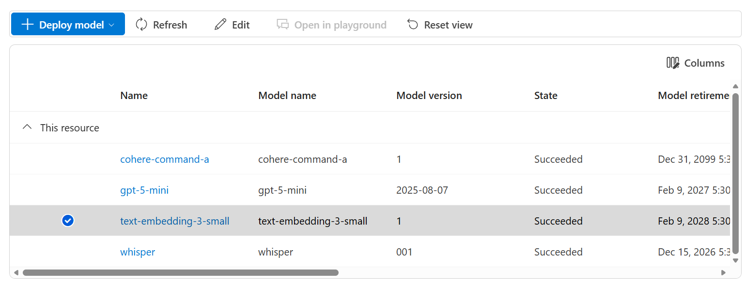
Model Deployment
(Put the screenshot of the model selected in the “models + deployments” section here)

Slide 18
Azure AI Search Service Creation
Proprietary content. © Great Learning. All Rights Reserved. Unauthorized use or distribution prohibited.

Slide 19
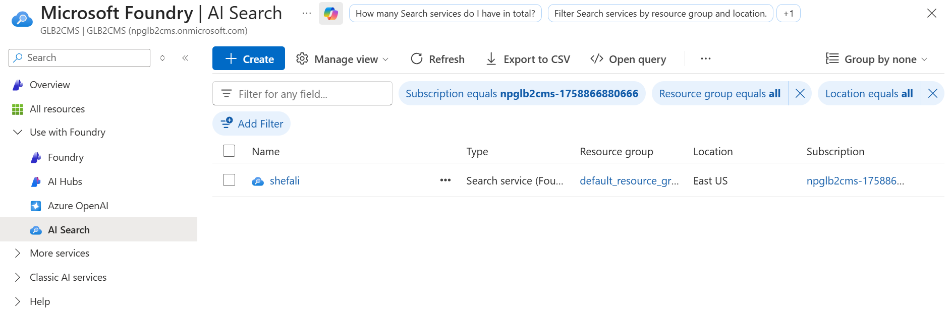
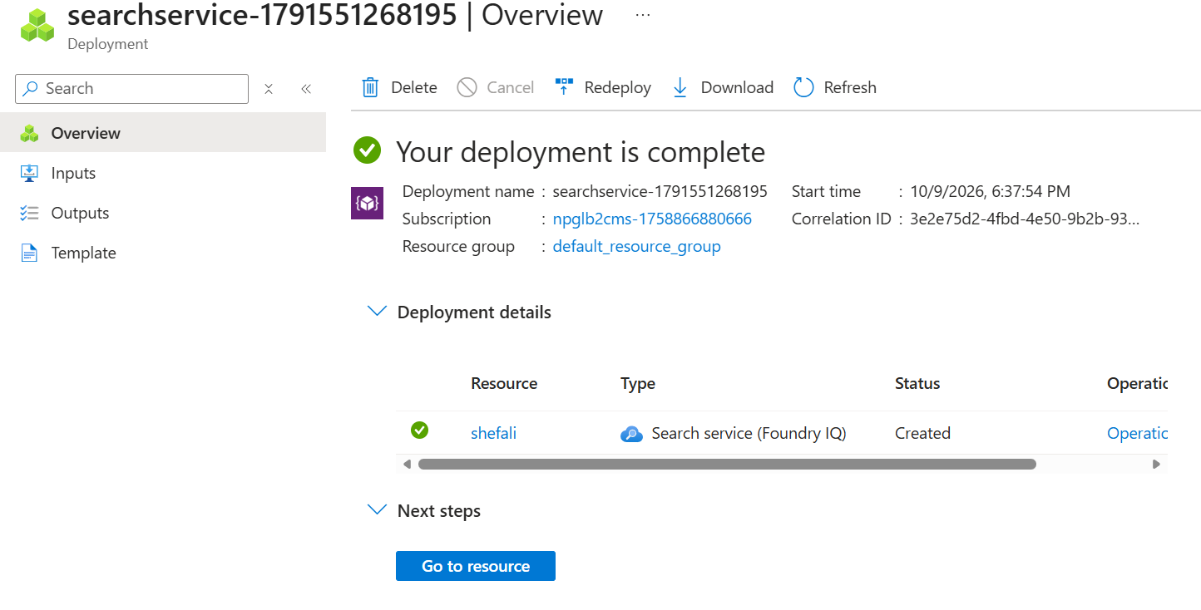
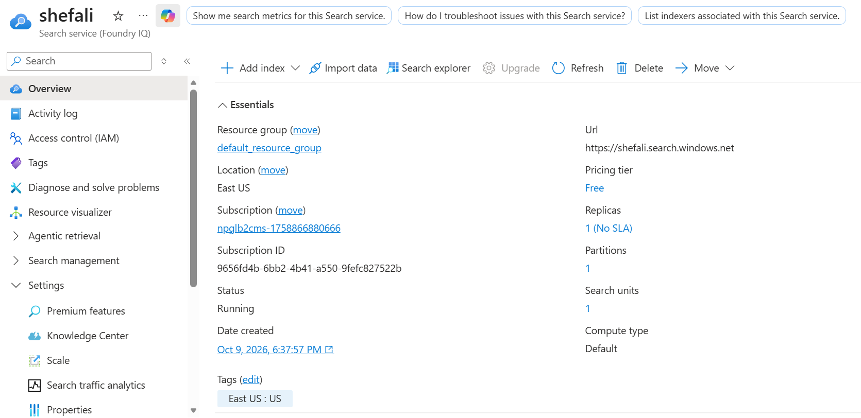
Azure AI Search Resource creation
(Put the screenshots and details during Azure AI Search Resource creation here)
Proprietary content. © Great Learning. All Rights Reserved. Unauthorized use or distribution prohibited.

Slide 20
Azure Container Registry Service Creation
Proprietary content. © Great Learning. All Rights Reserved. Unauthorized use or distribution prohibited.

Slide 21
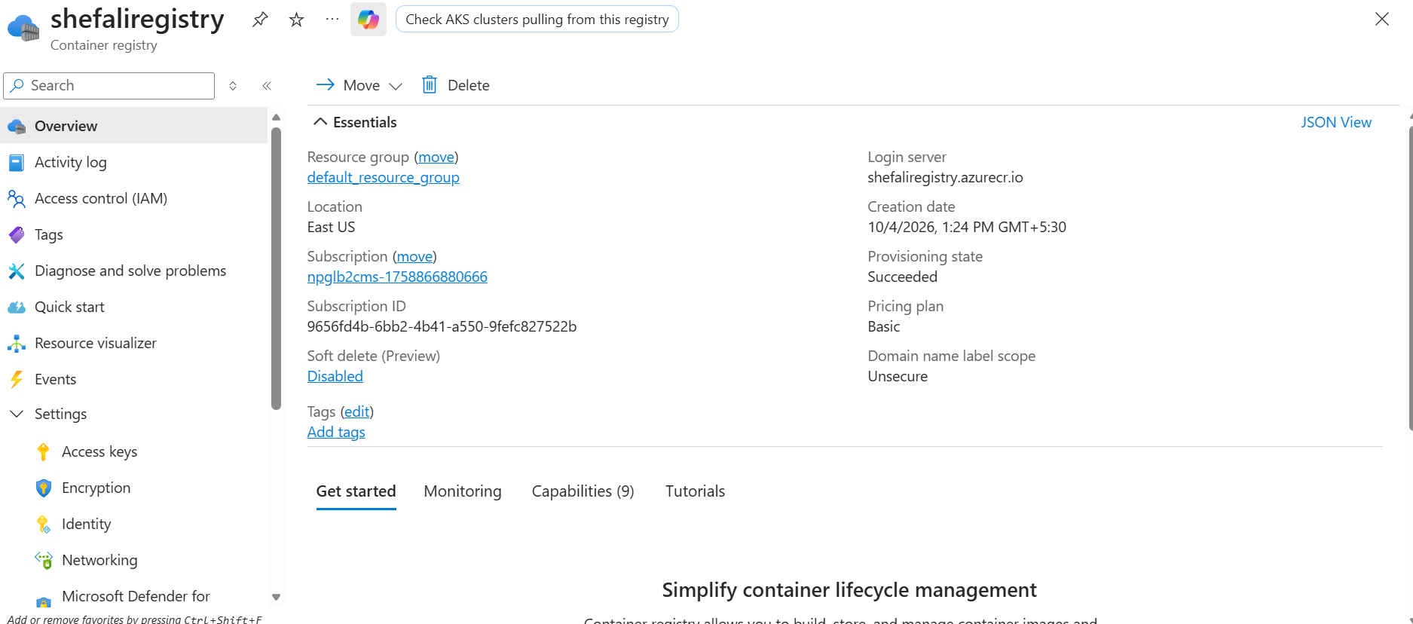
Azure Container Registry service creation
(Put the screenshots and details during Azure Container Registry Resource creation here)
Proprietary content. © Great Learning. All Rights Reserved. Unauthorized use or distribution prohibited.

Slide 22
Azure App Services

Slide 23
Azure App service creation
(Put the screenshots and details during Azure App Service creation here)
Proprietary content. © Great Learning. All Rights Reserved. Unauthorized use or distribution prohibited.

Slide 24
Step 3: Project Architecture

Slide 25
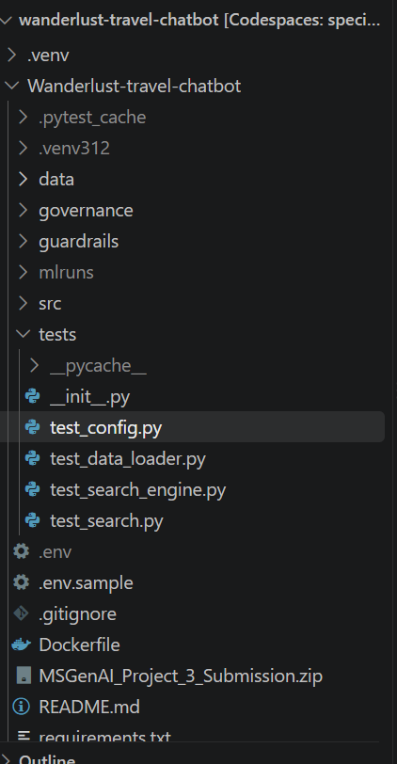
(This section should include screenshots of the project folder structure and a brief description of each folder and its purpose.)
Project Architecture: Folder Structure
Component | Purpose
src/ | Core RAG application logic
config.py | Centralizes configuration, Azure endpoints, deployment settings, Search settings and MLflow configuration
data_loader.py | Loads source documents and performs document preparation/chunking
ingestion.py | Orchestrates ingestion from source data to vector index
vector_store.py | Creates/connects to the Azure AI Search vector store
search_engine.py | Performs semantic retrieval and grounded response generation
governance/ | Contains input/output governance logic
governance_gate.py | Validates queries and generated responses
data/ | Stores source travel knowledge used for ingestion
tests/ | Unit/regression testing of major application components
requirements.txt | Python package dependencies
start_mlflow.sh | Starts local MLflow tracking service
.env | Runtime configuration/secrets, excluded from submission/version control

Slide 26
(This section should include a diagram and an explanation of how the components within the project folder structure interact with each other.)
Project Architecture: Component Interaction
Offline ingestion flow
Online query flow
Observability flow
data/
↓
data_loader.py
↓
ingestion.py
↓
Azure OpenAI Embeddings
↓
vector_store.py
↓
Azure AI Search
User
↓
Governance Gate
↓
search_engine.py
↓
Query Embedding
↓
Azure AI Search
↓
Top-K Chunks
↓
Azure OpenAI
↓
Output Governance
↓
Answer
Ingestion
│
├────► MLflow
│
Search
│
└────► MLflow

Slide 27
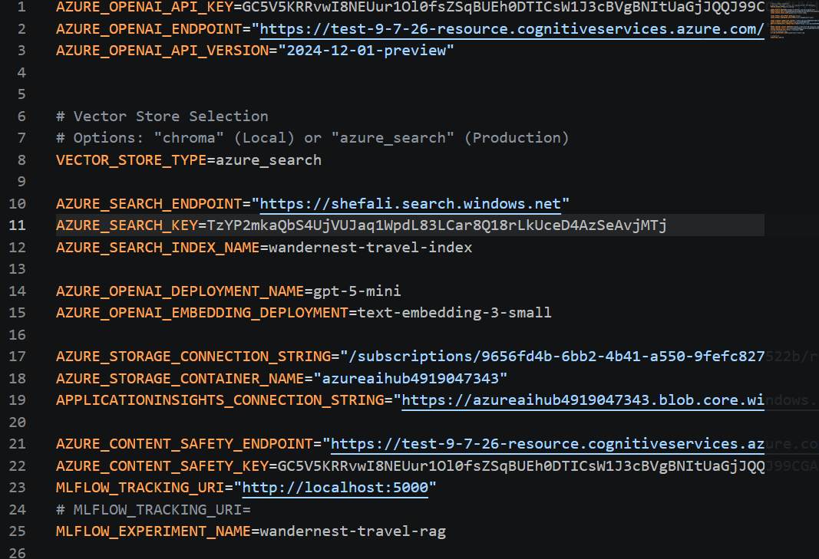
(This section should include a screenshot of the credentials that need to be configured in the .env file, along with a brief description of each.)
Configure ‘.env’
Configuration | Purpose
AZURE_OPENAI_ENDPOINT | Endpoint used by the application to connect to the Azure-hosted OpenAI resource.
AZURE_OPENAI_API_KEY | Credential used by the application for key-based authentication to Azure OpenAI.
AZURE_OPENAI_API_VERSION | Specifies the API version used by the application when invoking Azure OpenAI.
AZURE_OPENAI_DEPLOYMENT_NAME | Identifies the deployed chat/generative model used to create the final grounded response. Azure model settings use the deployment name selected when the model is deployed
AZURE_OPENAI_EMBEDDING_DEPLOYMENT | Identifies the embedding-model deployment used to vectorize documents and user queries for semantic retrieval
AZURE_SEARCH_ENDPOINT | Connects the application to the Azure AI Search service used as the vector retrieval layer. In your implementation this is shefali.search.windows.net.
AZURE_SEARCH_KEY | Authentication credential used to access Azure AI Search.
AZURE_SEARCH_INDEX_NAME | Identifies the vector index containing the ingested travel knowledge. Your project uses wandernest-travel-index.
MLFLOW_TRACKING_URI | Specifies where application runs and tracking information are sent to MLflow. Your development configuration uses localhost:5000.
MLFLOW_EXPERIMENT_NAME | Groups related WanderNest executions under the configured MLflow experiment.
AZURE_CONTENT_SAFETY_ENDPOINT | Endpoint for the Content Safety service, if enabled in the project.
AZURE_CONTENT_SAFETY_KEY | Authentication credential for Content Safety, if enabled

Slide 28
Step 4: Running the Application
(Data Ingestion → Application → Evaluation)

Slide 29
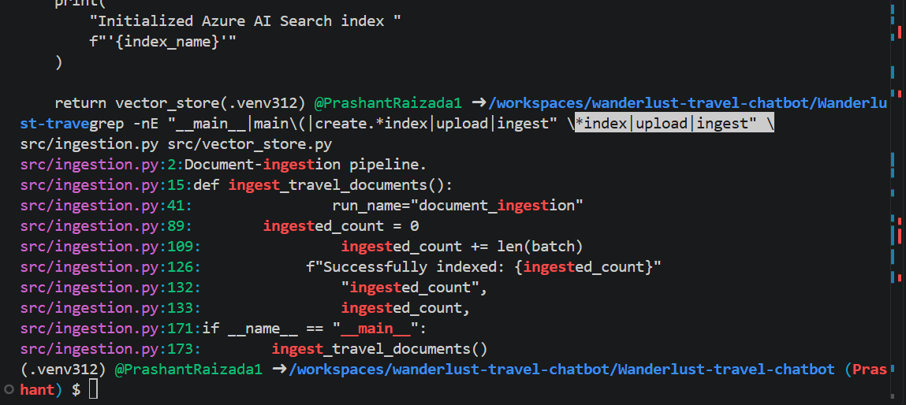
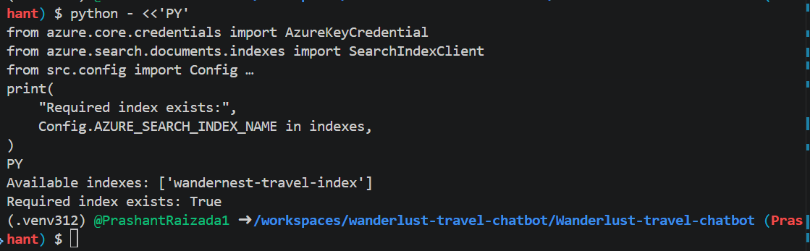
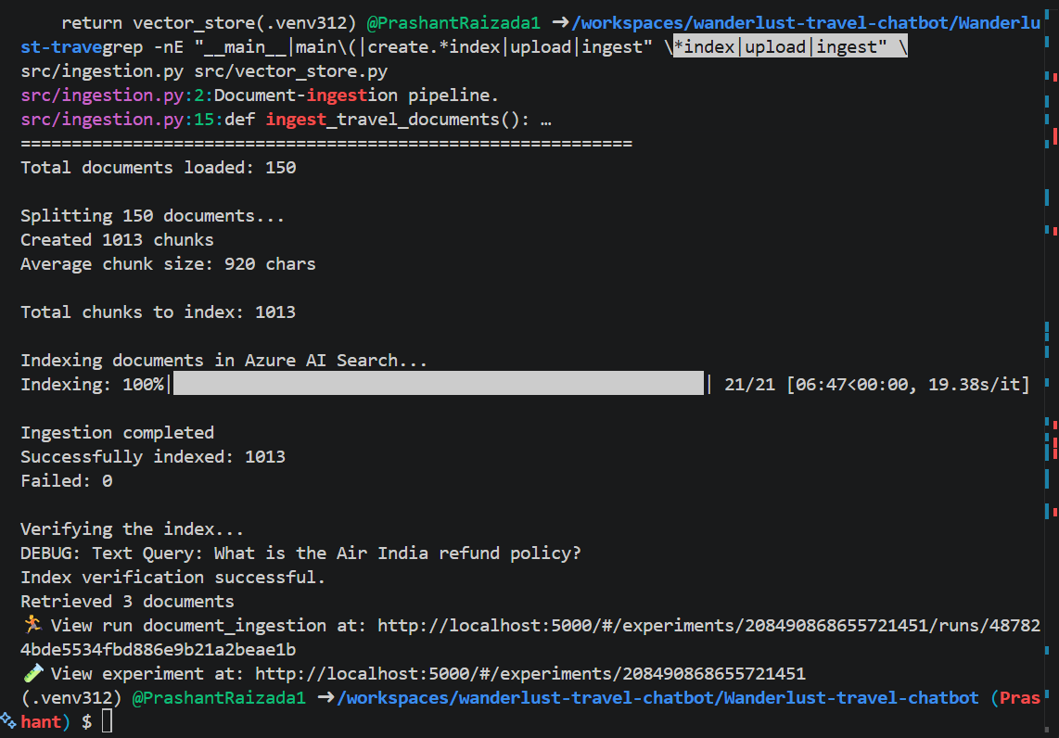
(This section should describe how to execute the data ingestion process and include a screenshot of the output)
4.1 Data Ingestion Execution
Travel Data
PDF / CSV
│
▼
data_loader.py
│
├─ Load documents
├─ Extract content
└─ Split into chunks
│
▼
Azure OpenAI
Embedding Model
│
▼
vector_store.py
│
▼
Azure AI Search
wandernest-travel-index
│
▼
Verification Query

Slide 30
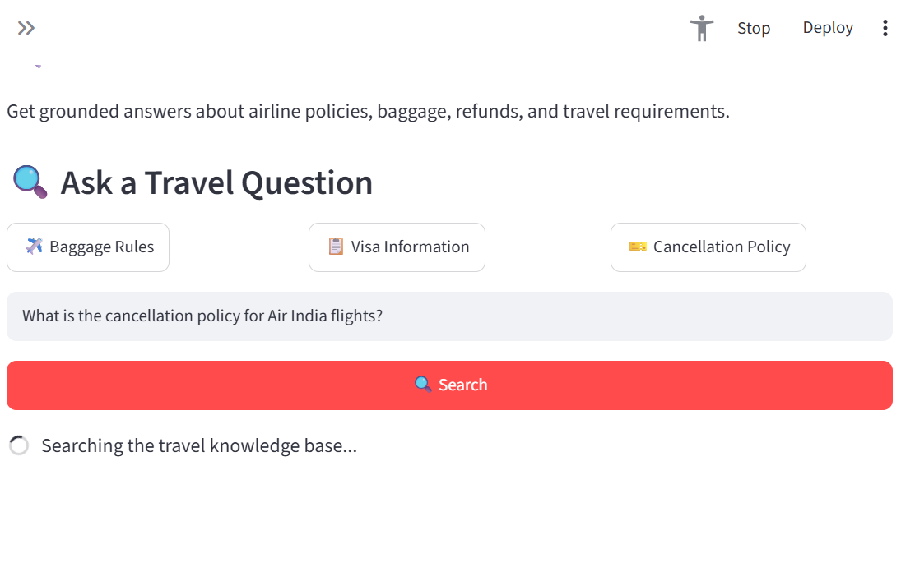
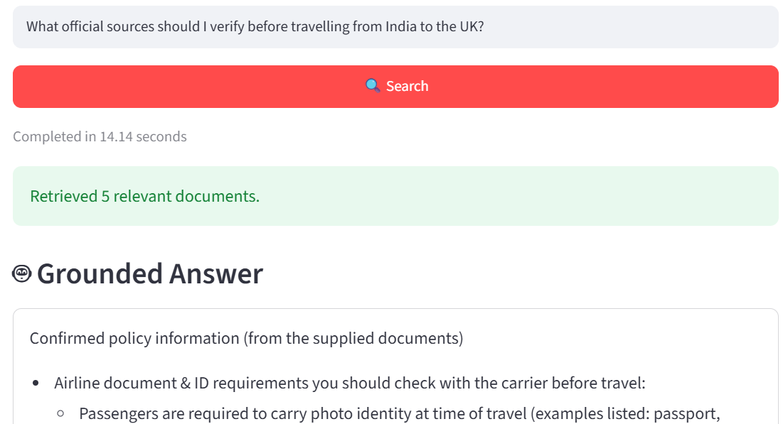
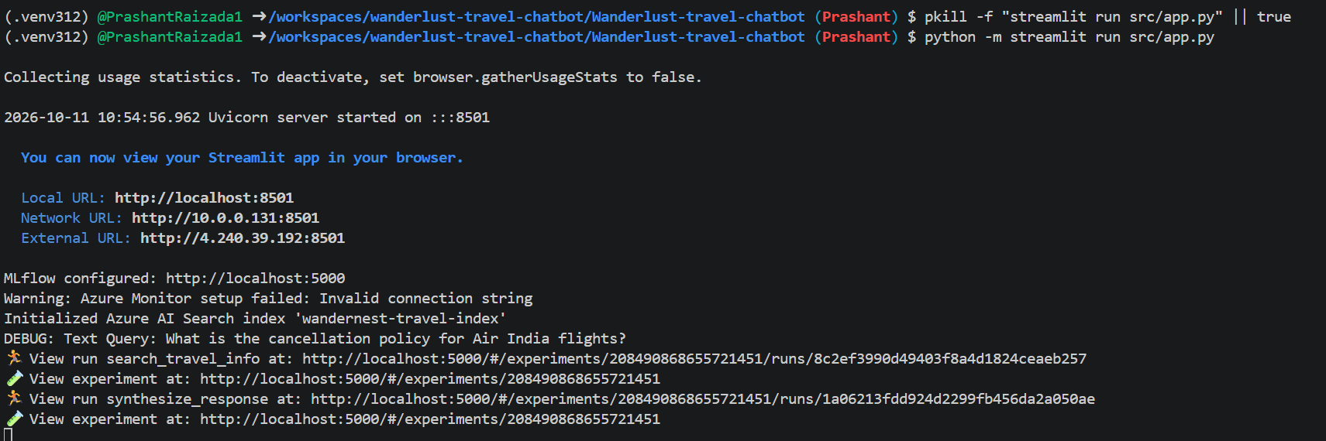
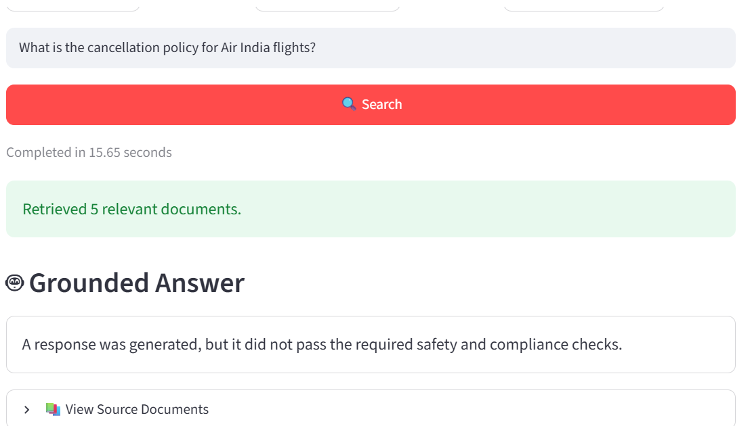
(This section should describe how to execute the Streamlit application and include a screenshot of the output UI)
4.2 Running the Streamlit Application

Slide 31
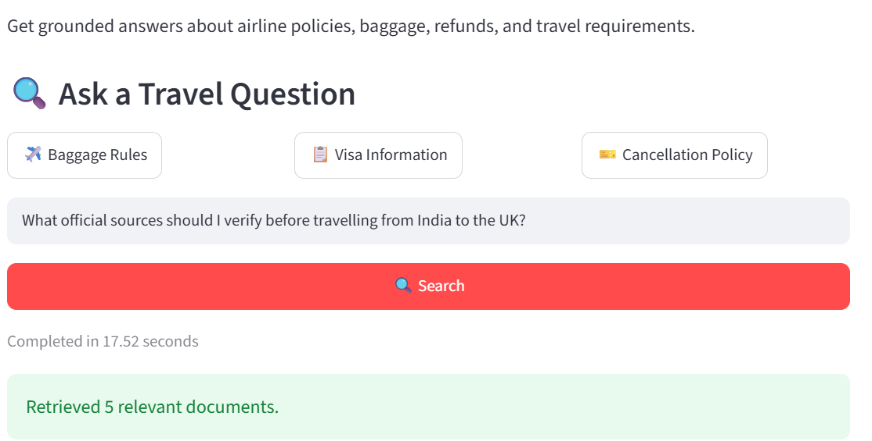
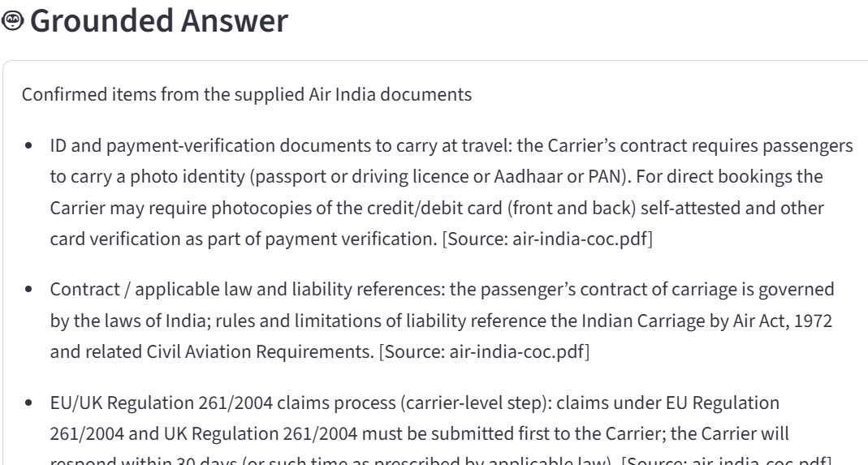
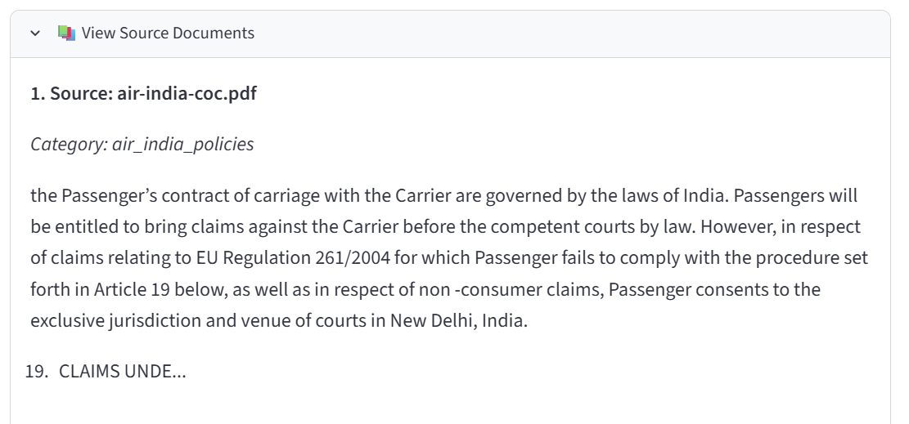
(This section should describe how to run a RAGAS evaluation to assess the performance of the RAG system, explain the evaluation metrics, and include a screenshot of the output)
4.2 Running RAGAS Evaluation
Test Question
│
▼
WanderNest RAG
│
├── Retrieved Context
│
└── Generated Answer
│
▼
RAGAS
│
┌────┼--------┐
▼ ▼ ▼
Retrieval Grounding Answer
Quality Quality Quality

Slide 32
Conclusion : Key Takeaways and Business Outcomes

Slide 33
Key Takeaways
Write the Key Takeaways here:
Grounded RAG combines enterprise knowledge with GenAI, while RAGAS enables objective assessment of retrieval, relevance, and response faithfulness.

Slide 34
Expected Business Impact
Write the Expected Business Impact here:
Faster access to trusted information, improved answer reliability, lower hallucination risk, and a repeatable framework for continuous RAG quality improvement.

Slide 35
Power Ahead!

